Slide 1
CS 580 Research Project: Reinforcement Learning
Aaron Yang, Mike Riches, Ruochen Hua

Slide 2

Reinforcement Learning
What is RL?
Why use it?
Implementation
Experimental results
Real world scenarios
Demos!

Slide 3

What is RL?
RL teaches an AI agent how to play a game
Simulates “Cause-and-effect”
Unsupervised learning

Slide 4
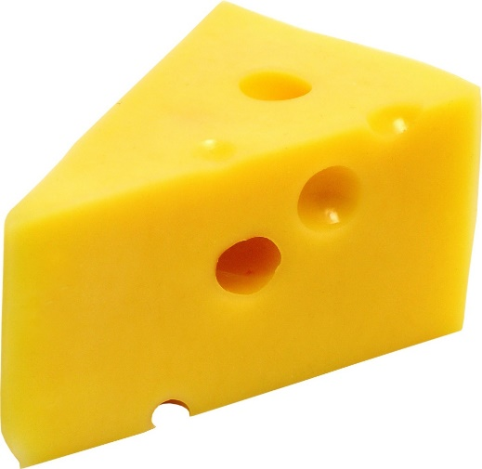
What is RL?
Stores, updates, and uses a Policy
Policy provides best action for a given game state
“Q-value” is assigned to each possible action
Success or failure influences the Q-value for an action taken
“Cause-and-effect”
Repeat successful actions
Avoid unsuccessful actions

Slide 5

Benefits of RL
Agents provide challenging gameplay
RL can respond to player's actions
RL can provide better challenges
More replay value
Produce intelligent “agents”
Provide challenging gameplay
Add replay value
Respond to player's style and choices

Slide 6

Implementation choices
Can be used offline or online – or both!
Game state representation
Pick and choose the parameters you think should apply
Represent only the state that applies to RL agent
Must represent all possible combinations
Memory storage: size vs. speed

Slide 7

RL Challenges
Many “epochs” required
Bake smart agents
Can still use gameplay
Balancing new choices vs. learned choices
Learned methods might not fit new situations
Use randomness to introduce new methods
Pick best algorithm
Q-Learning
SARSA

Slide 8
Q-Learning
Q-value: the value of taking action in state under a policy.
HOW IT WORKS:
Choose a action base on learned data(policy).
Take the action and observe the reward.
Update Q-value for the state using the observed reward
Go to Step 1.

Slide 9
Sarsa

Slide 10
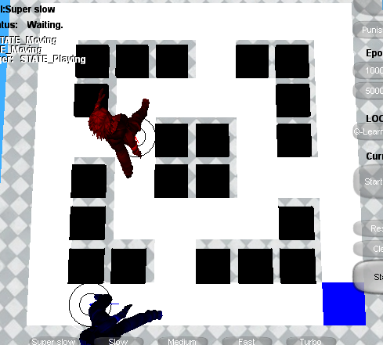
Rules of the game
The mouse scores a point for getting the cheese. Then replace cheese randomly.
The cat scores a point for catching the mouse. Then game is over!

Slide 11
Q-Learning in this game
Q-value: the evaluated value of moving mouse to 8 directions.
State: positions of mouse, cat and cheese.
Choose an action(move direction) base on learned data(policy).
Take the action and observe the reward. Got cheese, Reward= +50 . Caught by cat, Reward=-100.
Update Q-value for the state using the observed reward
Go to Step 1.

Slide 12
Technique and Implementation
Rabin’s framework and c++
Rlearner: run learning algorithm and update policy.
RLPolicy: a database to store Q-value
Rlworld: a presentation of a game environment.
RLGame: control the game overflow and maintain all setting.
Update UI
RLGame
run training
RLearner
RLWorld
query action
RLPolicy
Update policy

Slide 13
Show time!
greedy and smart.
Before and after training.
The more iterations you run, the smarter mouse you will get.
different terrains.
When reward is larger than penalty, mouse will go for the cheese no matter what.
Other factors

Slide 14
Games using reinforcement learning
Board games
Strategy games
Fighting games
Racing games
In research

Slide 15
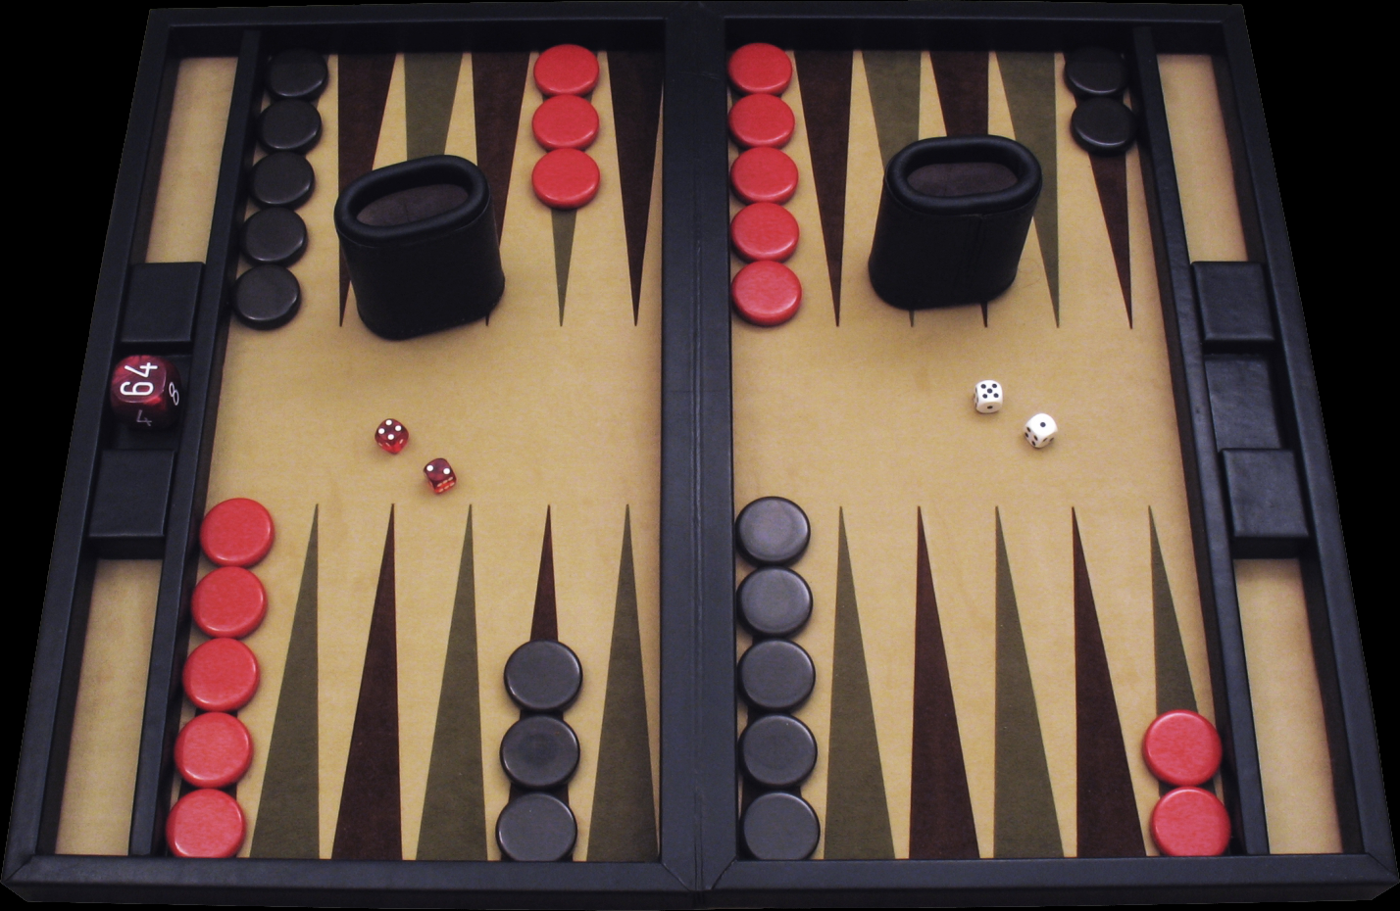
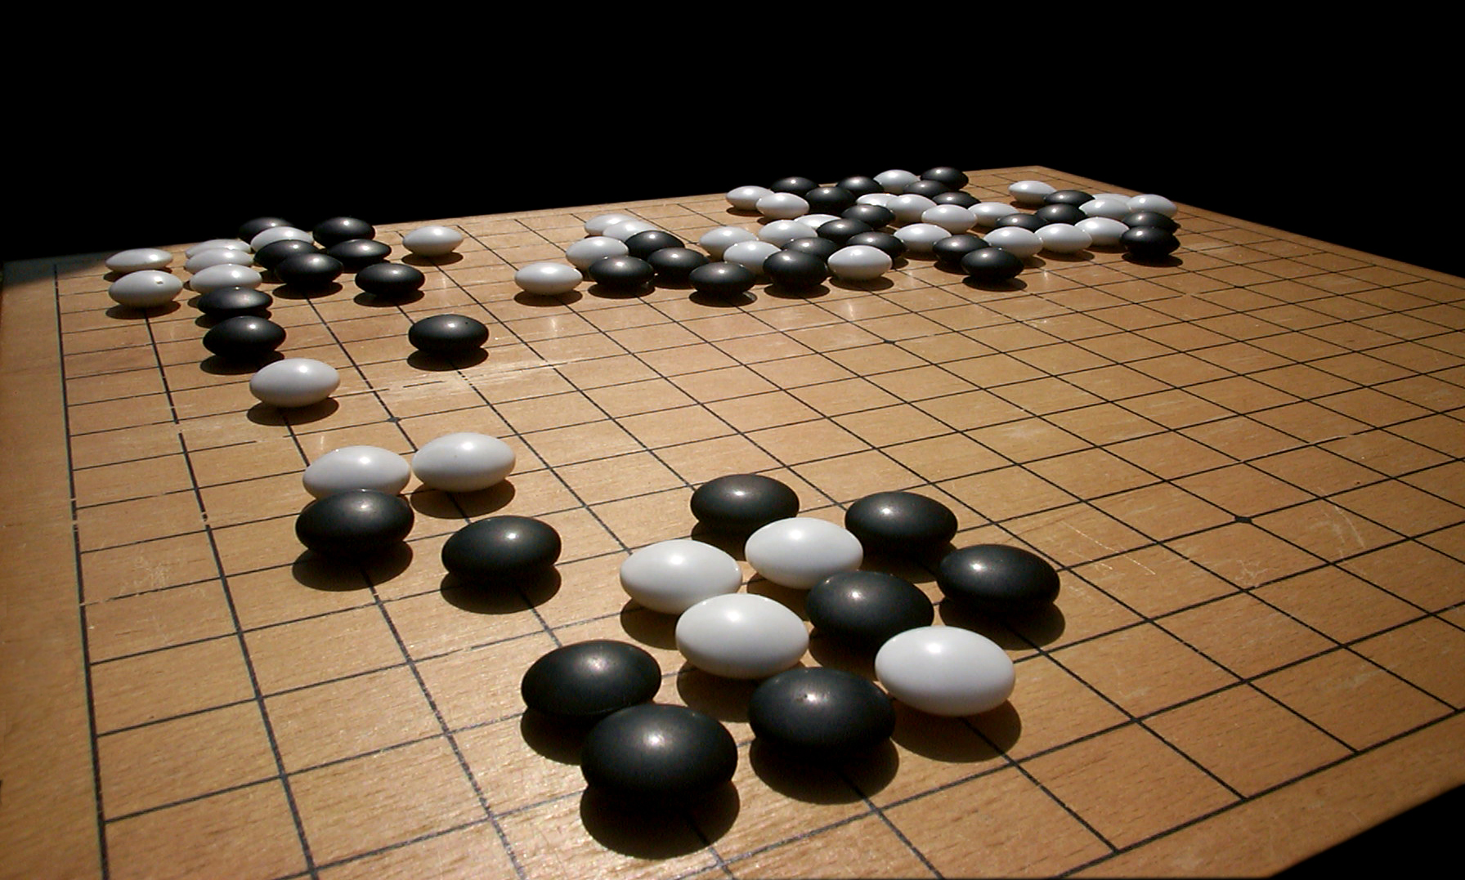
Board games
GO
Backgammon

Slide 16
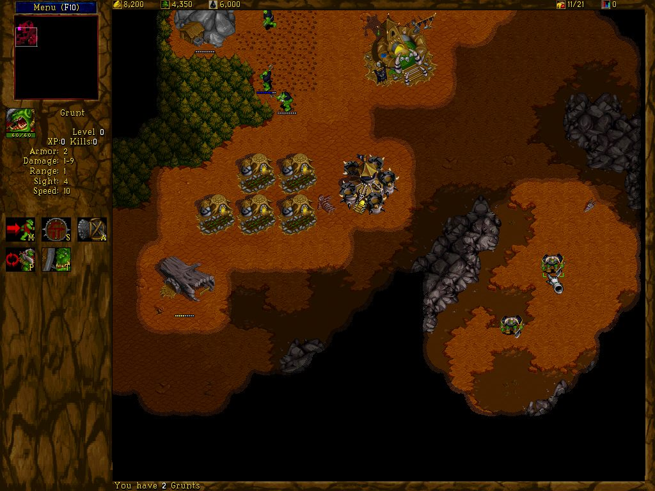
Strategy games
Wargus

Slide 17

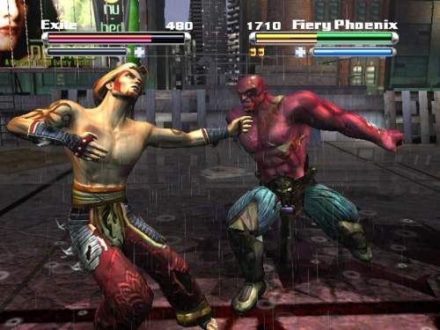
Fighting games
Tao Feng

Slide 18

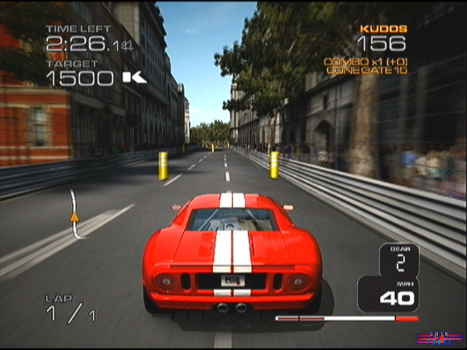
Racing games
Project Gotham Racing 3

Slide 19
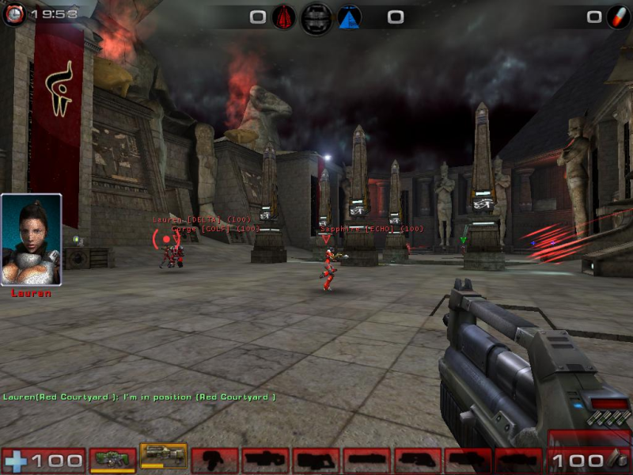
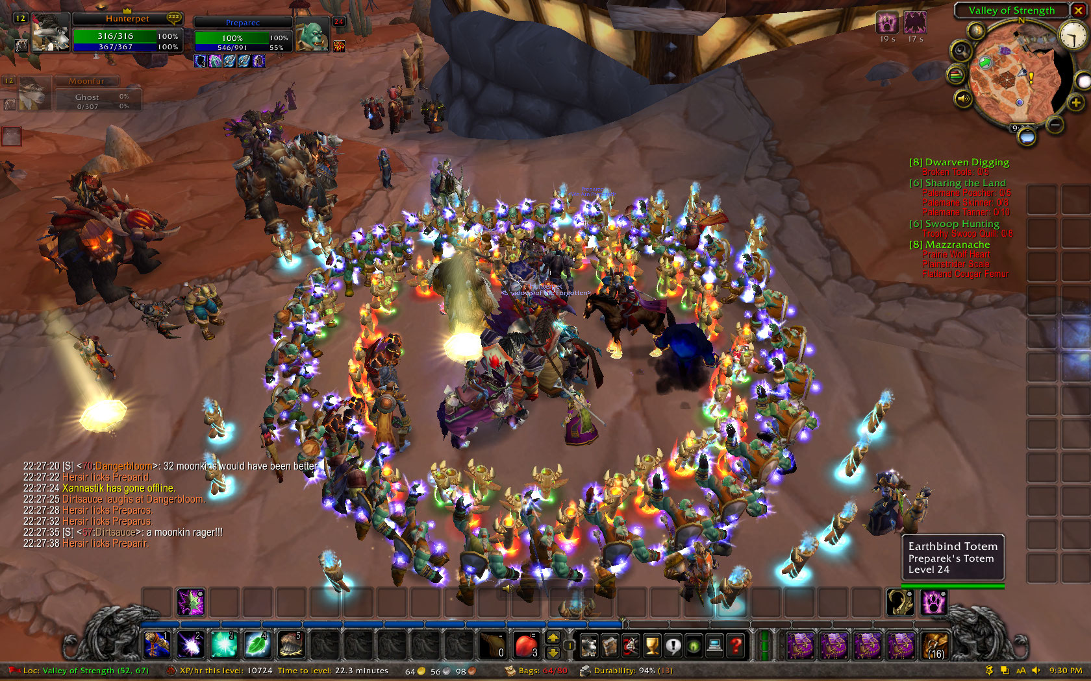
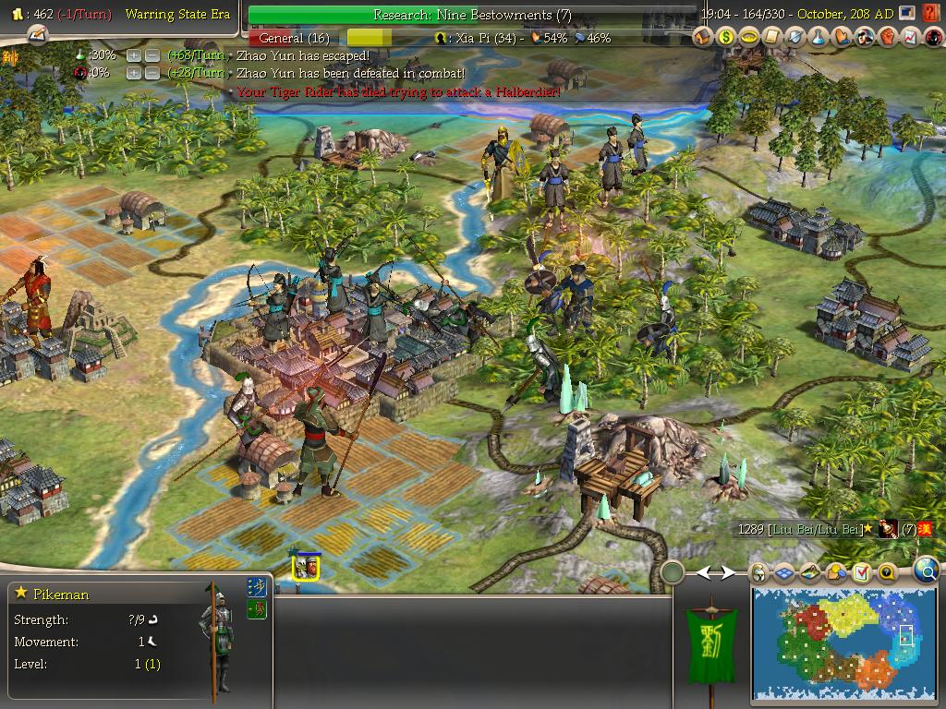
In research
World of Warcraft
Unreal tournament
CIvilizatin

